Slide 1
IoT Security Project
Using Motion Sensors as an Adversary
Hammad Anjum (190797)
Ahtsham Saeed (190817)
Faizan Khokhar (190852)
Notes:
Hi everyone, my name is Chang Min Park, and I’m a PhD Candidate at the University at Buffalo.
Today, I’m going to present our paper Rushmore.
Rushmore is a system that securely displays static and animated images using TrustZone.
(Click)

Slide 2
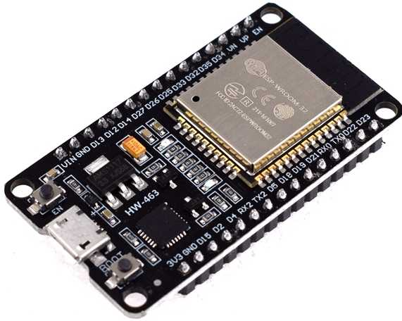
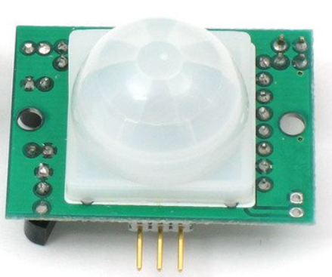
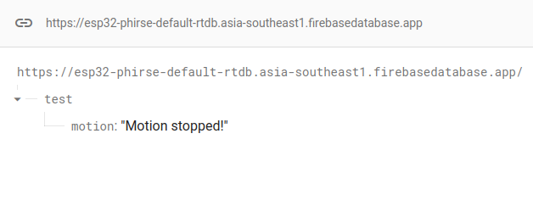
Normal Scenario
Esp32
Motion Sensor
Firebase

Slide 3
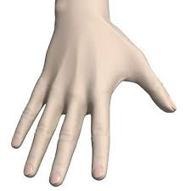
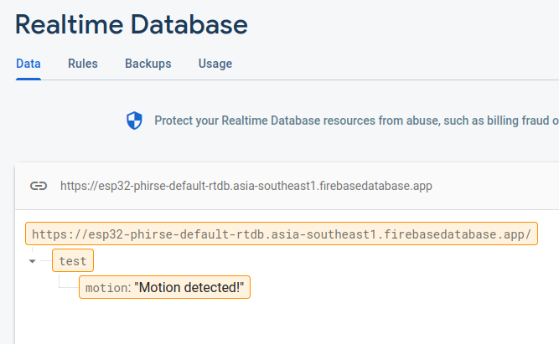

Normal Scenario
Wave hand around Motion Sensor
Esp32
Firebase
Notes:
Here’s a typical workflow to display a confidential image on a mobile device.
(Click) First, tursted party sends a confidential image in an encrypted form.
(Click) And, an application on a mobile device decrypts the image and displays on the device screen.

Slide 4
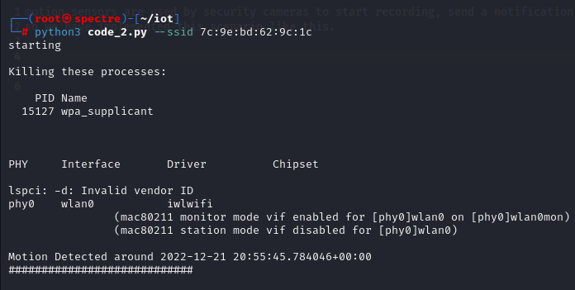

Attack Scenario
Attacker
Wave hand around Motion Sensor
Firebase
Esp32
Notes:
Here’s a typical workflow to display a confidential image on a mobile device.
(Click) First, tursted party sends a confidential image in an encrypted form.
(Click) And, an application on a mobile device decrypts the image and displays on the device screen.

Slide 5
Thank You.

